Slide 1
2024 Candidate for IACP Vice President at Large

Slide 2
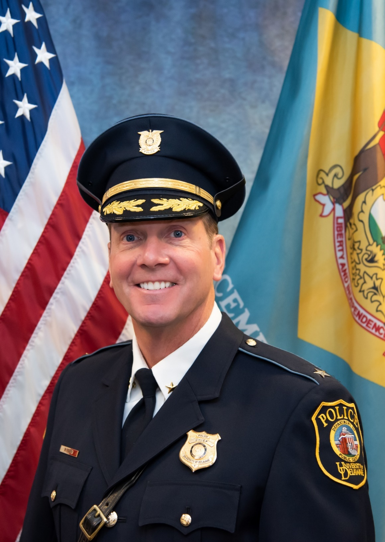

Slide 3
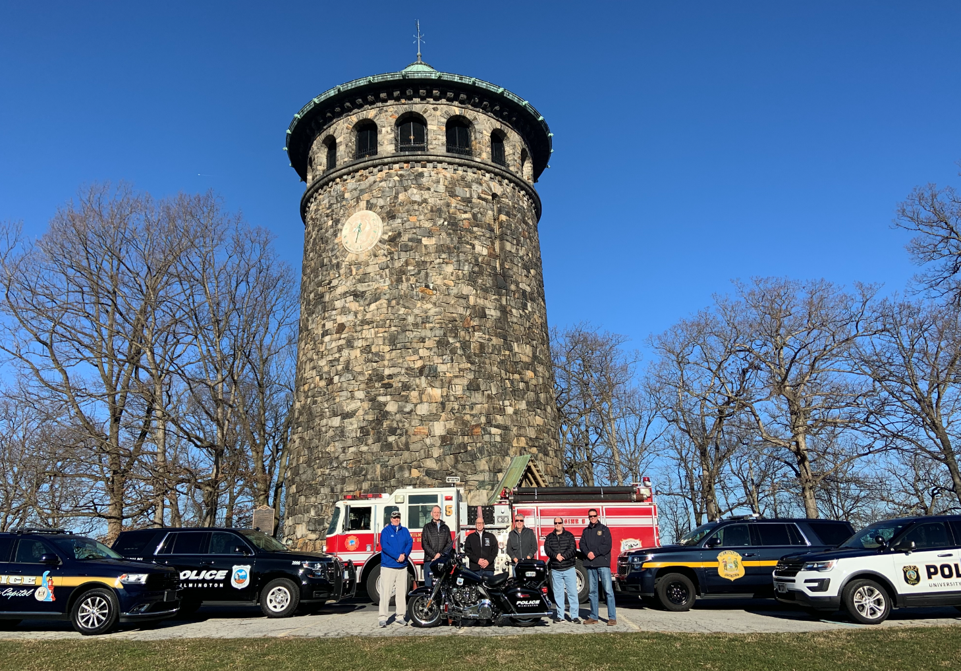
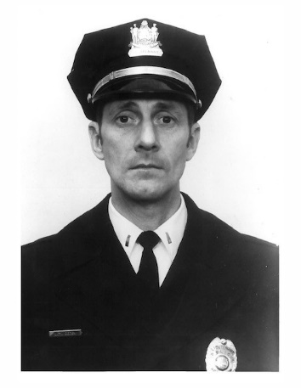

Slide 4
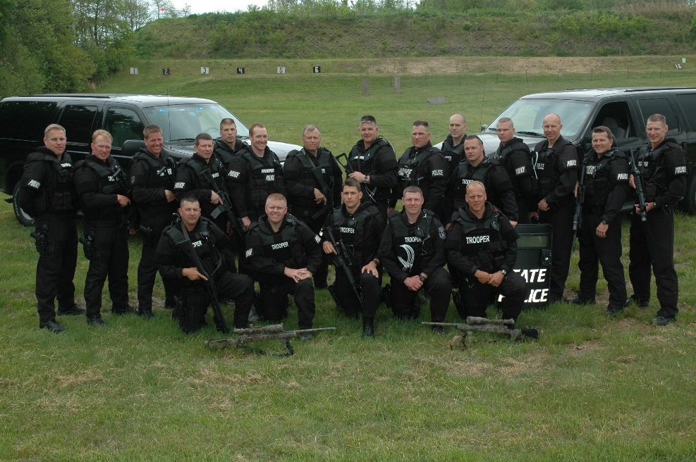
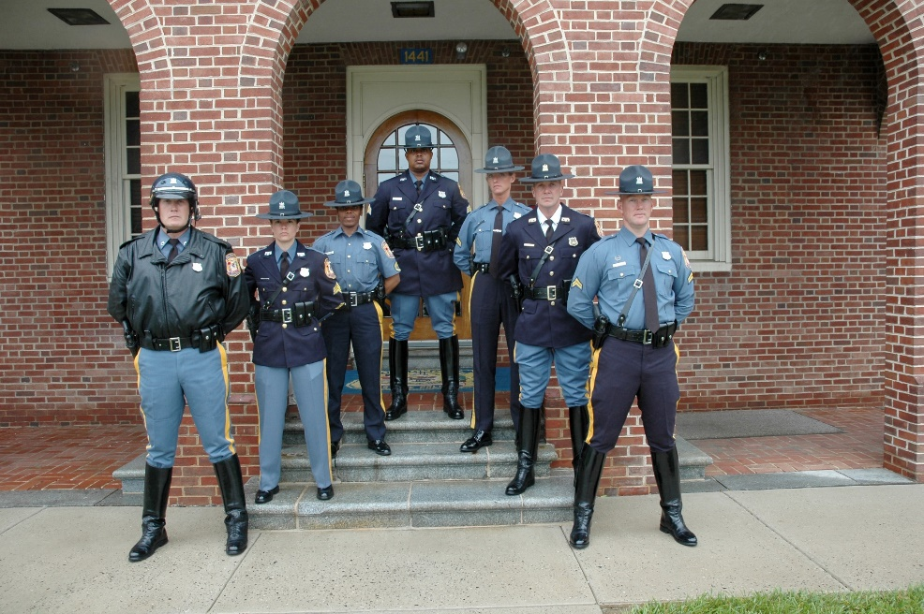
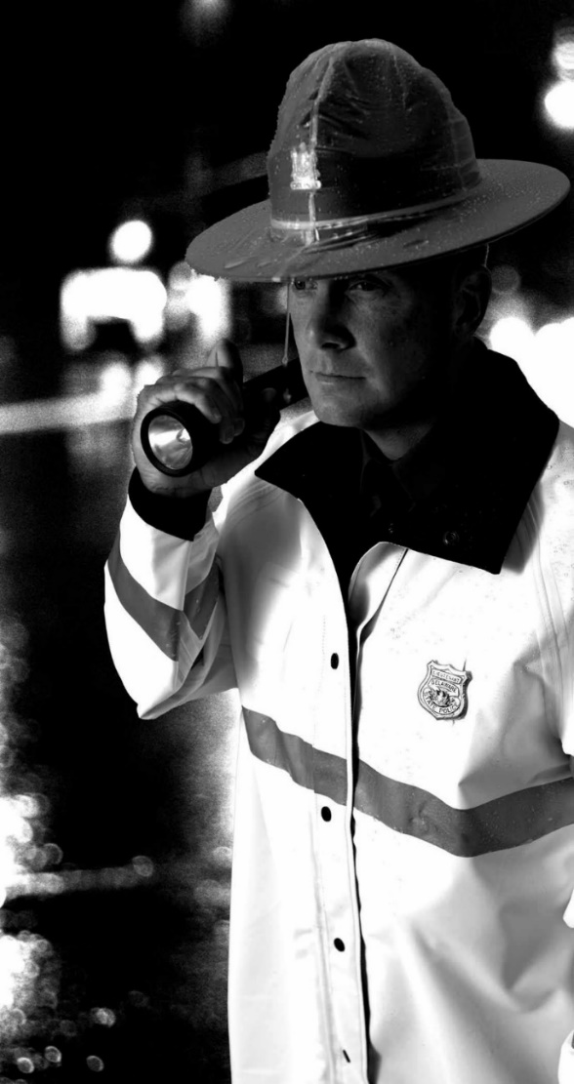
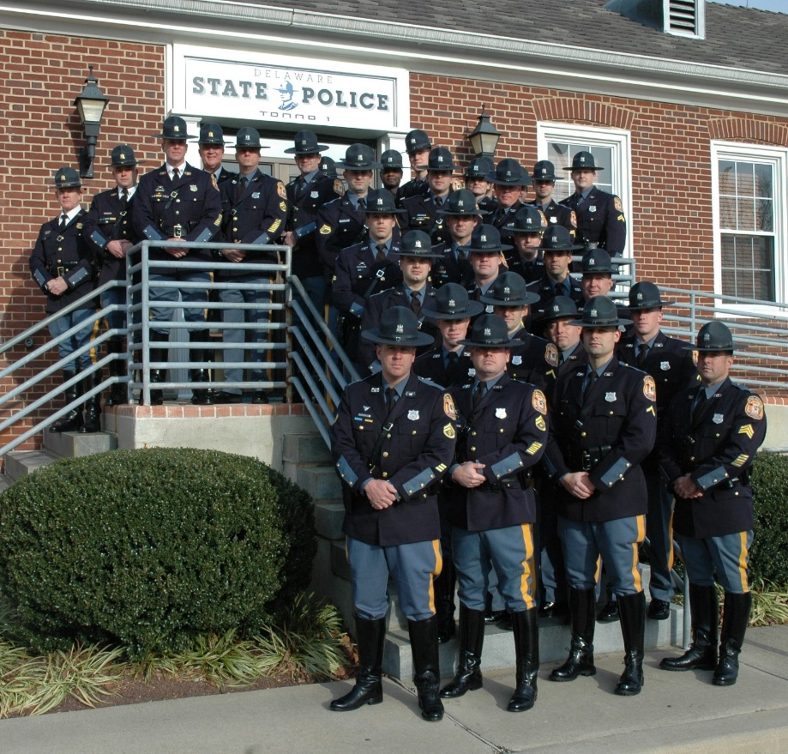
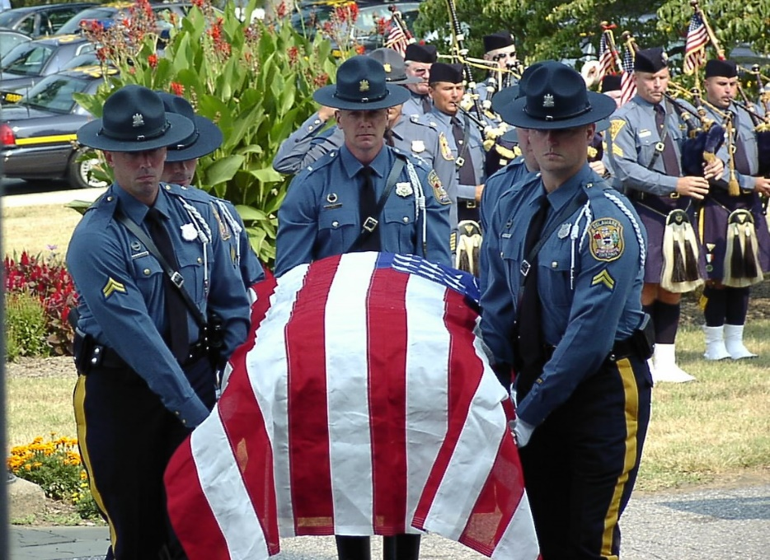

Slide 6
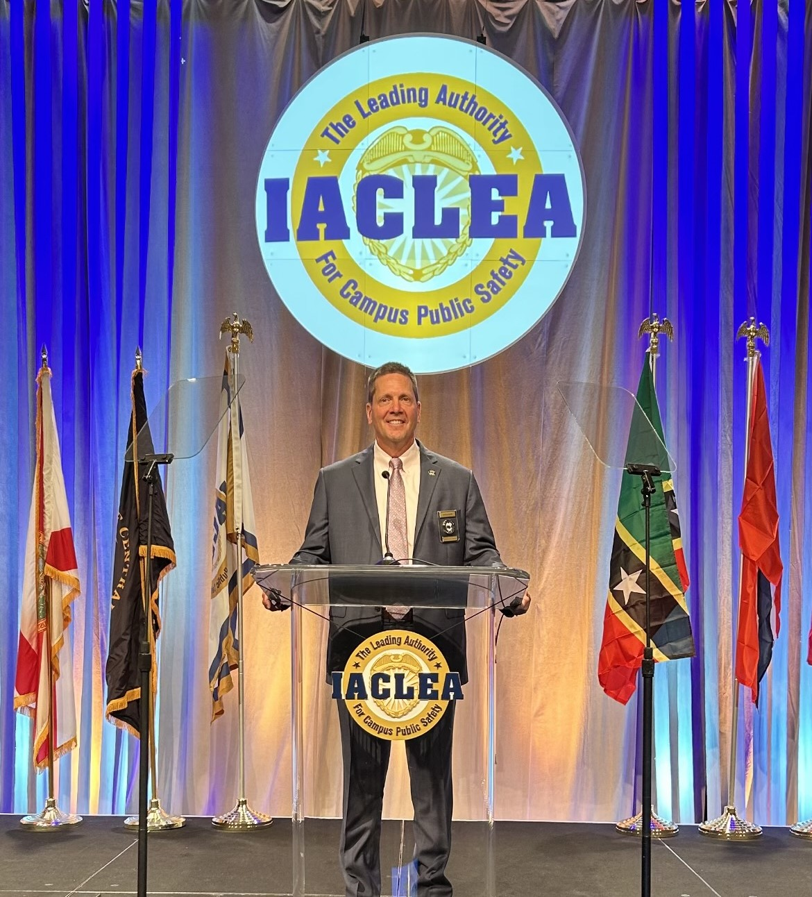
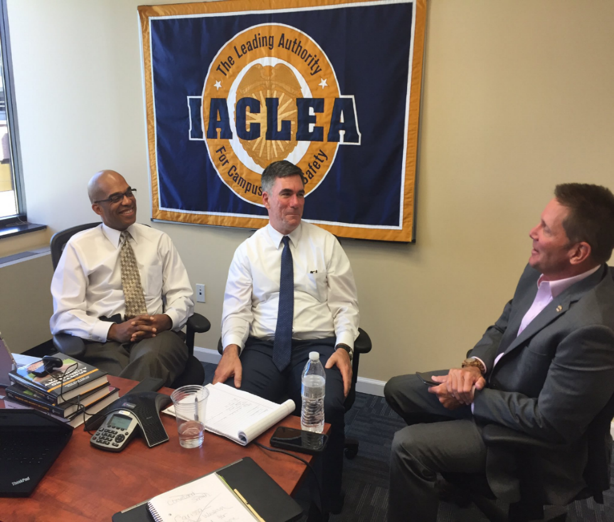

Slide 7
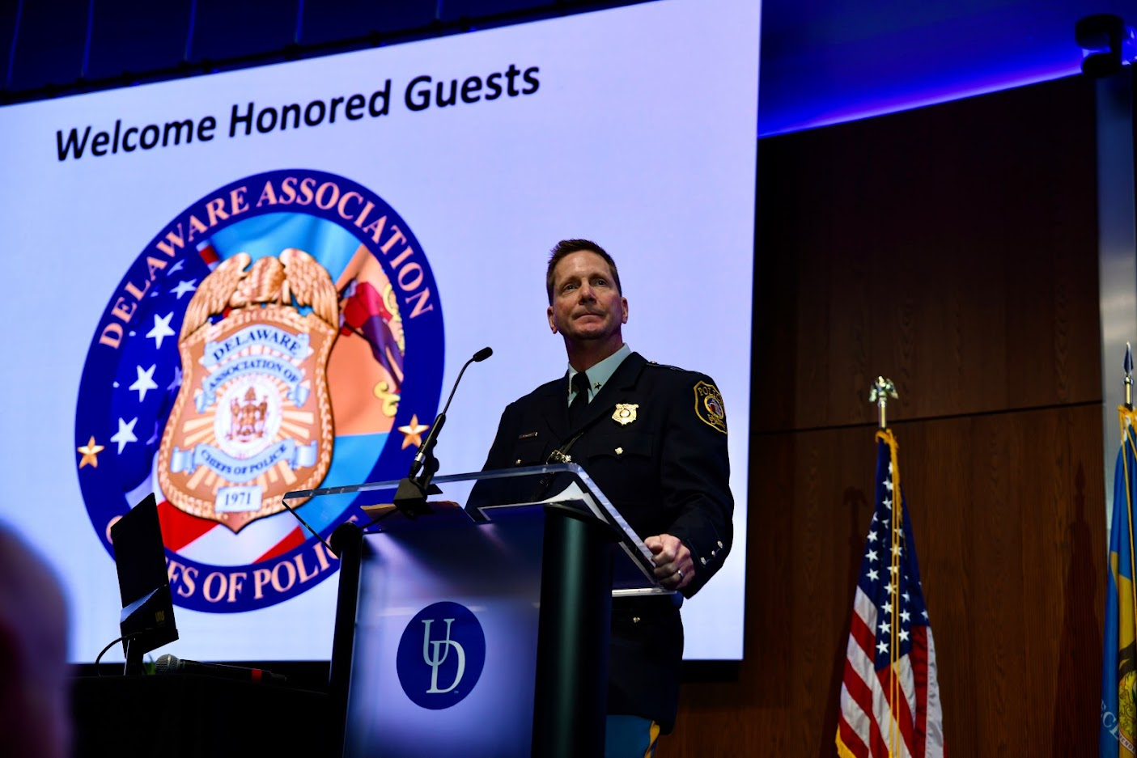

Slide 8
IACP 2024 Vice President At Large CAMPAIGN PLATFORM
Officer Safety, Wellness, Physical and Mental Fitness
Recruitment and Retention (30X30 Initiative)
Professionalism and Branding
State Accreditation
Advancing Technology
Delivering High Quality Training
Enhanced Supervision and Leadership

Slide 9
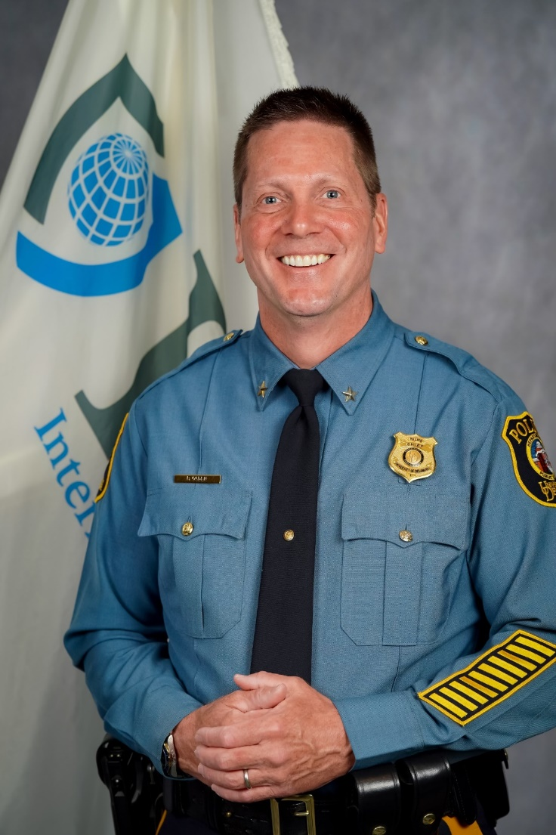
Commitment to the IACP
Appointed member of the IACP Board of Directors
Member of the State & Provincial Alumni Association
Member of the Firearms Committee
Vice Chair for the University and College Police Section
Served as the SACOP representative for Delaware
Passionate about the Trust Building Campaign, One Mind Campaign, and being a good Teammate within the Board of Directors

Slide 10
Supporting Associations from my 2023 campaign for 4th Vice President

Slide 11
